Slide 1
Data Democratization

Slide 2
Today’s Agenda
1
Welcome
2
Overview
3
Benefits
4
Data Democratization Solution Overview
5
Close

Slide 3
Data Governance Overview
Susan Wilson
Vice President Data Governance and Privacy

Slide 4






Managing Data Is Getting Harder
Explosion in Data Volume
New Users
New Data Types
(mobile, social, IoT)
Data in the Cloud
Machine Learning/AI
20.6 zettabytes per year
in global data center traffic
500 million
business data users and growing
20 billion
connected devices
Over 94% of data center traffic
will come from the Cloud
1 billion workers
will be assisted by machine learning or AI

Slide 5


The Role of the CDO is Shifting
DATA
Risk and Compliance Management
GDPR, CCPA, FERC, MIFID, BCBS 239, MDR, IFRS17
Notes:
Evolution in CDO office

Slide 6

The Role of the CDO is Shifting
Driving business value
Business Goals
Revenue Growth
Cost Reduction
Margin Expansion
Talent Management
Corporate Governance
Business Objectives
Product/Service Innovation
Customer Focus
Operational Efficiency
Data Driven Culture
Market Reputation
Regulatory Compliance
DATA
80% of organizations with a high ability to innovate have strong data sharing practices both internally and beyond company borders.
MIT Sloan: Data & Analytics Global Executive Study
Notes:
Front and center in driving business value
Driving business tranformations
New products and services
New optys op efficiencies

Slide 7
Data Democratization Drives Business Value
Broad, consistent, and easy consumption of data for all employees
EXECUTIVE TEAMS
DATA SCIENCE TEAMS
Management Reporting
DataOps & Model Training
SELF
SERVICE
MANUFACTURING TEAMS
$
FINANCE TEAMS
Overall Equipment Effectiveness
Financial Planning & Analysis
PROCUREMENT TEAMS
MARKETING TEAMS
Spend Under Management
Personalized Next Best Offer
Notes:
What does Data Democratization looks like?
Data democratization is driving business value
Self service access to finance, marketing, manufacturing
Through providing consistent and easy to use access to data
Data sharing is essential to drive business value through data

Slide 8

Drivers of Data Governance
1. Insights & Analytics
3. Business Enablement
Self Service
Data Quality & Privacy
Predictive Analytics
Data Driven Decisions
Data Lake Reporting
Data Definition & Understanding
Data Lineage
Change Management
Customer Experience
Customer Satisfaction
Market Penetration
Business Decision
Data Ownership
Elimination of Silos
Enterprise Collaboration
2. Regulations
4. Digital Transformation
GDPR
CCPA
FERC
MIFID
BCBS 239
MDR
Cloud Migration
Data Warehousing
Data Lake Management
Data Explosion
Data as an Asset
Notes:
Susan

Slide 9
Organization Landscape
Data Management
Business
Managing the growing complexity of data in multiple systems & applications. Creating a data digitalized platform to support business consume-ability
Looking to define, understand and trust data to support regulatory compliance, analytics, risk management, customer experience, etc.
IT Personas
Business Personas
Data Architects
Data Engineers
System Owners
Database Admins
Technical Stewards
Data Governance
Data Analyst Data Scientist
Privacy Officer
Business Stewards
Governance Managers
Notes:
We see Data Governance teams thriving where they’ve engaged lines of business and data management

Slide 10



Data Needs to Be Clean, Prepared and Trusted
80% of time
Is spent on search and data preparation *1
25% of useful data
Created in 2018 was tagged *2
60% of organizations
Are challenged
by data quality *1
13% of tagged data
Was used
for analysis *2
Sources
*1 - IDC, End-User Survey Results: Deployment and Data Intelligence in 2019, #US45652419, Nov 2019
*2 - IDC, Worldwide Global DataSphere Forecast, 2019-2023, #US44615319, Jan 2019
Notes:
You can govern the data
Clean prepared and trusted to its
Effecitively enable data sharing in the enterprise
And the problem isn’t just on the Data Science side, either. Because, as the number of data consumers across the business who require data to do their analytics grows, the requisite know-how to find and access the data they need, technical skill or baseline data literacy, falls through the floor.
Organizations can try to compensate for this gap with training and enablement, but what’s really needed is to meet these business data consumers where they are, with a self-service model tailored to their needs and capabilities.

Slide 11
And it Needs to be Easy to Access and Consume
Population
New Self-Service Model
Technical Skill
Data Scientist
ETL Developer
Data Engineer
Citizen Integrator
Citizen Analysts
Citizen Consumer
Technical
Business
Notes:
Challenge is the audience
As we start to work with the business working edge…
Population is much larger than technical power users
Technical Skillset declines
Self service model that enables citizen consumers in your organization
And the problem isn’t just on the Data Science side, either. Because, as the number of data consumers across the business who require data to do their analytics grows, the requisite know-how to find and access the data they need, technical skill or baseline data literacy, falls through the floor.
Organizations can try to compensate for this gap with training and enablement, but what’s really needed is to meet these business data consumers where they are, with a self-service model tailored to their needs and capabilities.

Slide 12



Benefits of Data Democratization
Greater Collaboration Across Enterprise
Find Relevant Data Assets
Reduce Cost of Operations
Greater Trust and Compliance
Data Governance
Enterprise Data Catalog
Data Privacy
Data Quality
Control
Operate
Consume
Companies that empower employees to consistently use data as a basis for their decision making, are nearly twice as likely as others to report reaching their data and analytics objectives.
McKinsey: How Leaders in Data and Analytics Have Pulled Ahead
Data
Democratization
Build
Measure
Automation Scale Intelligence Powered by CLAIRE
Data Warehouse | Data Lake | Master Data Management | Analytics
Notes:
Organanizations need mm capabilities to power their cdw/l
Enables
Do it with EDC and DG&P

Slide 13

The Data Empowerment Expert Series
Monthly webinar series featuring best practices from within our data governance & privacy community
Upcoming webinars include stories from LA Care, FIS, New York Life, Deutsche Leasing, Invesco, Genworth, UNC Health and more
Each month, we’ll publish a new story during the last week of the month
Tell your customers to subscribe to each story at www.informatica.com/dataexperts

Slide 14
Intelligent Data Governance
Value
Quality
Collaboration
Agility
AI/Automation
Trust
Democratize
Business
Relevance
Lineage
Protection
Enterprise
Privacy
Reduce
Risk
Adoption
End to End
Connected

Slide 15
Business Benefits of
Data Governance
with Informatica
Kate Amory
Principal Technical Marketing Manager Data Governance

Slide 16
Challenges to Consider
Traditional Failure Points for DG
The Informatica Offering
Scale & Automation
Manual Effort
Manual effort is a killer of DG initiatives, governance as DG can be seen as a burden rather than an enabling force.
We can minimise the amount of manual effort involved by automating where possible (and scaling up fast!)
Analysis Paralysis
Building a DG framework can be a tall order, often leading to up-front delays or deep customisation down the line.
Agile DG Framework
We provide 25 pre-defined facets which have been carefully designed to give you guidance and consistency while still allowing for flexibility.
Inability to Execute
Defining terms is not enough, Enterprise Data Management has many elements which need to work together seamlessly.
Extensible Model
We connect the logical view to the physical, to data quality checks to security measures – all on one platform allowing you to take real action.
Notes:
The reality is, most organisations have tried and failed at DG at some time or another, so we wanted to dig into the reasons why and what we could do about them.
Click for 3 problem points on left side…
‘Its too much work’ – people run from the extra work they assume they will have to do as part of DG
‘No buy in from the business’ – DG team cannot make DG last alone, need to engage people across the board
‘We can find the problems, but what can we do about them?’ - definitions focused governance doesn’t solve broader problems
Click for 3 solution points on right side…
We automate the discovery and tagging of data as far as possible and even auto-apply DQ for key data elements
We recognise the needs of different personas and allow them to come in from their own tailored perspective
We provide more than point solutions, a full platform to allow your DG programme to grow and automate

Slide 17



Benefit of Scale: Keeping Up
Limited Scope: Regulatory Reporting
Human catalog creation is costly but doable
Enterprise Scope
Human creation is impossible with pace of growth
Machine curation is the only way to go
Notes:
And overall the benefit to this cannot be overstated
With the quantities of data companies are dealing with today, legacy systems and new data driven initiatives included, it is not just impractical but impossible to keep up
AI and ML can do the work for you, machines (informed by humans) can managed scale in a way we never could
All in all – the manual effort will never disappear completely, but can be massively reduced, which will
Free up your SMEs to let them do their day jobs
Allow them to take more out than they put in – key for engagement and adoption
Make your organistion more efficient, saving you time to save you money!
Scale = New York Life
Didn’t understand how important intelligence was
Wasn’t in initial set fo requirements
But actually
Auto-discover v important for us as we did not have time or documents to dive into
Don’t realise you will need it but it is this that will help you operate at scale
Don’t think initially but really save you time and pay dividends when your data stewards are building
Intelligent capabilities really important - really need to think about how you are going to scale up you operations.

Slide 18
“Our program has grown to the point where we needed a solution that could scale to over 50 million objects. Informatica was the only solution that could keep up with our pace.”
– Large Financial Services Firm
Notes:
Scale = New York Life
Didn’t understand how important intelligence was
Wasn’t in initial set fo requirements
But actually
Auto-discover v important for us as we did not have time or documents to dive into
Don’t realise you will need it but it is this that will help you operate at scale
Don’t think initially but really save you time and pay dividends when your data stewards are building
Intelligent capabilities really important - really need to think about how you are going to scale up you operations.

Slide 19
How do we achieve this? Scalable Data Tagging
Found and tagged based on the name of the column
Found and tagged based on the abbreviated column name
Found and tagged based on similarity to tagged field
Phone Number | Tele Nmbr | DEUTSCHE_TE | FIELD 42 | gobbledygook
020 7484 7893 | 01398 323 306 | (541) 763-3540 | (555) 3424324 | 020 7484 7893
+44 7984 239234 | (541) 754-3010 | (541) 754-3010 | 07948 234 438 | +44 7984 239234
01 47 05 49 15 | 0208 675 8223 | (541) 783-3333 | (717) 432-4432 | 01 47 05 49 15
Found and tagged based on XREF table of local german phone numbers
Found and tagged based on regular expressions: 07948; 555; 717
Notes:
Firstly, we need to minimise the amount of manual effort required for DG
We have a number of ways of finding and tagging your data to a business definition:
Click for boxes around Columns 1 & 2
Firstly, we will consider NAMES - the first two columns shown here would be found using NAME MATCHING, as we can locate based on abbreviations, acronyms and synonyms (or a mix of these) as well as exact matches.
Using just this technique, with one large customer, we were able to identify over half of the data with 99% accuracy
But as we know… data is not always well named, so we need to be smarter than this.
Click for boxes around Columns 3 & 4
Secondly, we will use DOMAINS (a fancy name for rules and groups of rules) to find data that is not well named.
For example we could use a cross-reference table to find these few German numbers in your organisation, or regular expression rules to locate those in column 4.
A good customer example was the names of chocolate bars – once we had a sample of them, they could be identified all over the place
Click for box around Column 5
Finally, we will leverage all that work by using SIMILARITY matching, so that even if your column is labelled gobbledygook we will know that as the data in it is THE SAME as in column 1 it must also be a phone number!
...remember all of this will be automatically done, you will set the thresholds and as lock the matches made are above the appropriate confidence level the physical fields will be AUTO-TAGGED to the business definition, making it easy for business people to locate the data they need!

Slide 20

Benefit of Automation: Business First
We have designed our solution to keep the decision-making power in the hands of the business
Automated-tagging links to business-defined KDEs
DQ NLP & Automation can be run from Axon, without tech support
Let technology be an enabler for the business, not a bottleneck

Slide 21
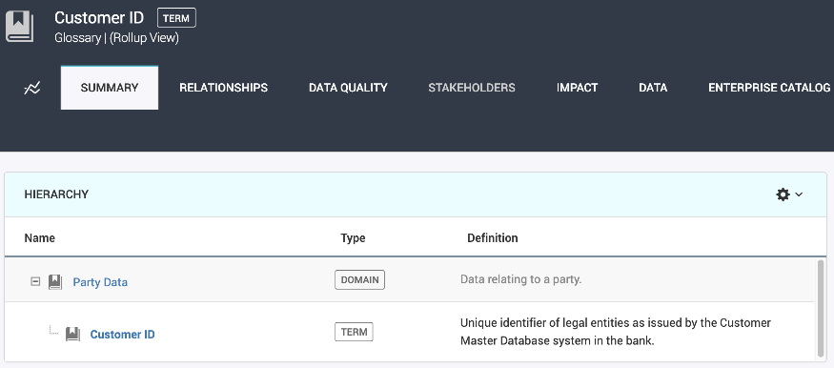
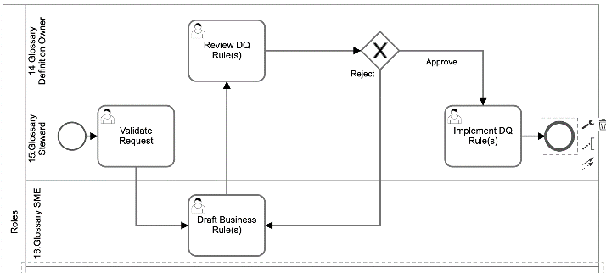
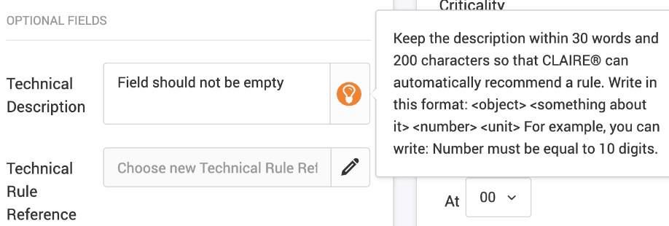
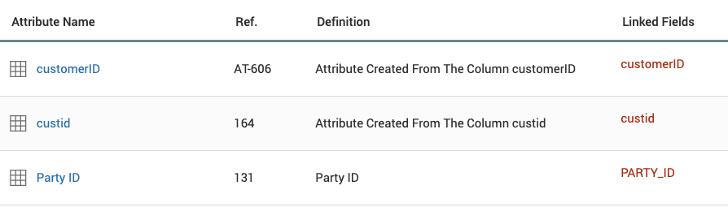
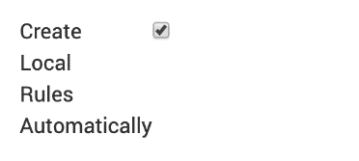
How do we provide this? Automated Data Quality
1
2
3
Define a
concept
Locate occurrences
Agree
Standards
4
5
6
Create Standard DQ Rule
Choose to apply automatically
Monitor DQ
at Scale
Notes:
1 Define a concept – what is a key element for your organisation?
2 Locate occurrences of that concept – where does it exist in systems?
3 Agree standards at conceptual level – do we all agree that customer ID should always be 10 digits to be valid?
4 Create a ‘standard’ for the concept – customer id must be 10 digits to be valid
5 Decide whether want to measure everywhere - not always the case, some rules will not be tracked in all systems e.g. timeliness is usually for specific reason in specific place
6 Monitor DQ at scale – see everywhere

Slide 22
“With the automation capabilities of Informatica’s Governance solution, we now have ‘on-the-fly’ multi-dimensional data quality rules and metrics that take mere minutes for each data attribute, whereas it took many hours prior to automation.”
– Gary Georges, Data Governance Program Manager
L.A. Care Health Plan
Notes:
Scale = New York Life
Didn’t understand how important intelligence was
Wasn’t in initial set fo requirements
But actually
Auto-discover v important for us as we did not have time or documents to dive into
Don’t realise you will need it but it is this that will help you operate at scale
Don’t think initially but really save you time and pay dividends when your data stewards are building
Intelligent capabilities really important - really need to think about how you are going to scale up you operations.

Slide 23
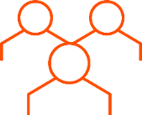

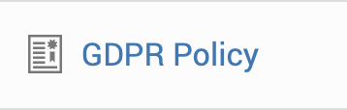
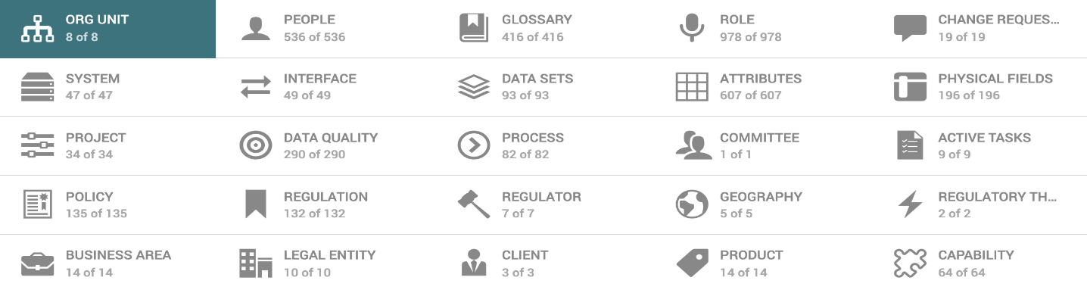

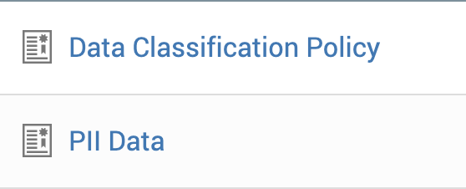
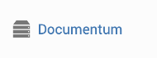
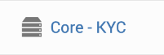
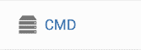
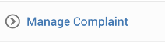

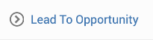
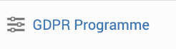
Benefit of Agility: Connections > Context > Community & Value
Where will my PII indicator go?
Notes:
Axon drives you towards better behaviours > McGraw Hill, one of oldest customers, 'Anyone can use Axon to focus on the business impact of data. You'll be able to get abusiness driven, global vision that's defined in partnership with technology enforced via the data governance team. All of that lends itself to removing the silos and increasing collaboration between business units and the IT Department.
If you put a PII indicator on a glossary term, only those who use that glossary term will see it.
If you create a classification policy and connect it you broaden your community.
That policy connects you to the context which it came from, the GDPR policy and GDPR reg
That classification can be reused in relation to systems and processes (meaning less maintenance, dont need a flag on each one that needs to be aligned)
And you’re community grows. The push towards more collaboration is built into design of the tool.

Slide 24
“Anyone can use Axon to focus on the business impact of data. You’ll be able to get a business driven, global vision that’s defined in partnership with technology and enforced via the data governance team. All of that lends itself to removing the silos and increasing collaboration between business units and the IT department”
– Roberta Pape, Director Data Governance
McGraw-Hill Education
Notes:
CHECK QUOTE REFERENCE

Slide 25
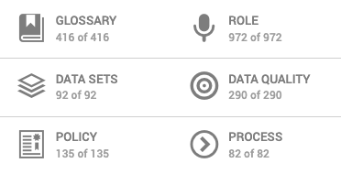
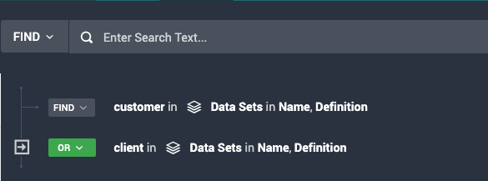
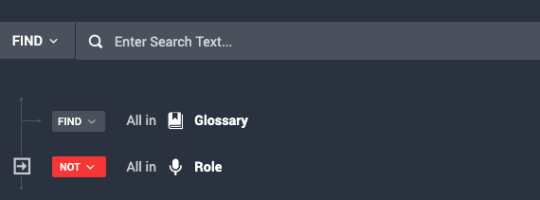
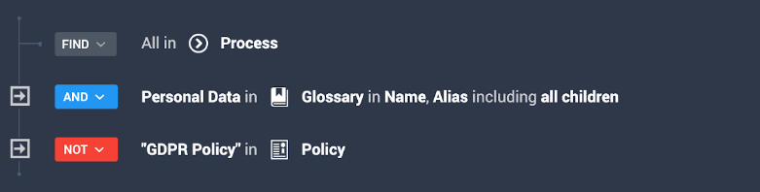
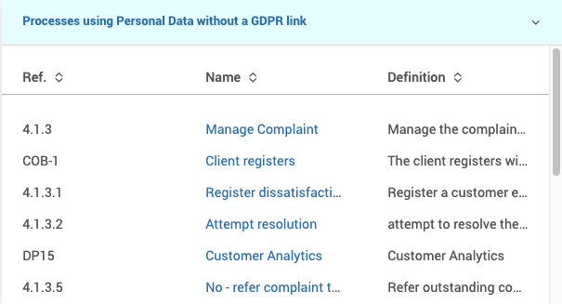
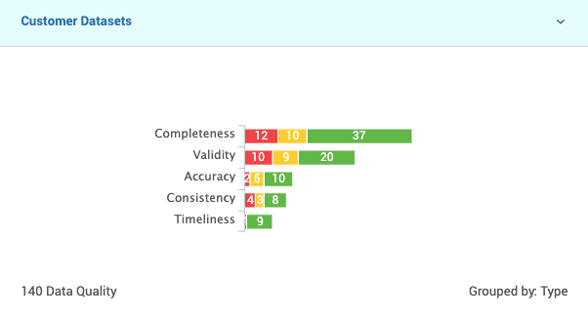
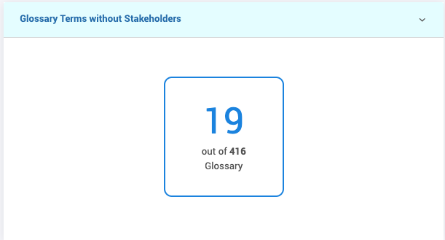



How can we leverage this Agile DG Framework?
Marketing Mgr
Data Steward
DPO
Notes:
Beyond the manual effort criticism, we need to ensure that we are integrating DG into our culture, for the many not the few
Click once to see facets appear
These 6 facets may be populated and maintained by completely different teams, but all sorts of different users can combine their content to answer questions critical to them
Click to see Data Steward appear, then keep clicking until see widget
For instance, a data steward might be in Axon to ensure definitions are well looked after and ownership is clearly established
…so they could search for which glossary terms do not have stakeholders as this would be of interest to them
...and they would track this number, chasing people to ensure that it went down!
Click to see Marketing Mgr appear, then keep clicking until see widget
However. a marketing manager might be in Axon to look for a customer dataset for their next campaign
…so they could search for which datasets contain the word customer or client in their name or description
...and they could even track these by their DQ scores, to ensure they were going after the best possible data for their next campaign!
Click to see DPO appear, then keep clicking until see widget
Finally. a Data Protection Officer might be in Axon to ensure compliance with a privacy regulation such as GDPR or CCPA
…so they could search for which processes are using personal data but have not been linked to the appropriate privacy policy
...and pin this list to their dashboard so they could immediately act upon this notable compliance gap!
All in all, the personas may be quite different, but the building blocks to get them to what they want will be the same. Informatica provides a consistent but agile framework for our customers to grow with.

Slide 26

Benefit of Agility: Consistency of Platform > Automation
One product line, creates all sorts of different cars
Once you have the model, you can re-use with ease & automate
An agile framework allows for flexibility, whilst maintaining a consistent basis
Intelligence can be built in and built up over time
Notes:
> Using an agile but consistent framework on your end, allows you to benefit from any and all of the advances on our end
> Car manufacturers don't re-build the product line every time they decide to make a new car, they leverage what they have, adapt and configure and doing so allows them to leverage learnings
> Don't reinvent the wheel, stick with what works and tweak to your preferences

Slide 27

Benefit of Extensibility: One Understanding > Deeper Dives as needed
One top-level overview, that allows you to see enough to gain context & improve understanding & collaboration
We need to see more of the world than we are used to, to affect change
Other connected, integrated capabilities that allow you to act
Axon is the connected view – EDC, DQ and DPM all enable it and extend what you can do with it.
Notes:
And…
Extensibility of understanding - by bringing in information from EDC, DQ, DPM etc. to Axon we allow even light biz users to extend what they see and care about.
We need to see more of the world than we are used to, to affect change

Slide 28
Benefit of Extensibility: Technological Fit
Master Data
Simplification
Data Marketplace
Risk Management
Data Discovery
Standards
Policy
Tracking
Data Quality
Domains
Lineage
Data Governance Foundation
Notes:
A common foundation allows teams to move between these individual tools without confusion / misalignment
Really this whole topic boils down to two things
Extensibility of technology - when you come to want to do something new, the additional product slots into your framework, saving you time, money & confusion

Slide 29
“When we saw how the Informatica tools integrated, selecting Informatica for our governance solution was a no-brainer.”
- Blake Andrews, Corporate Vice President of Data Governance Capabilities and Delivery
New York Life Insurance
Notes:
CHECK QUOTE REFERENCE

Slide 30
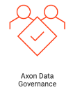
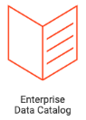


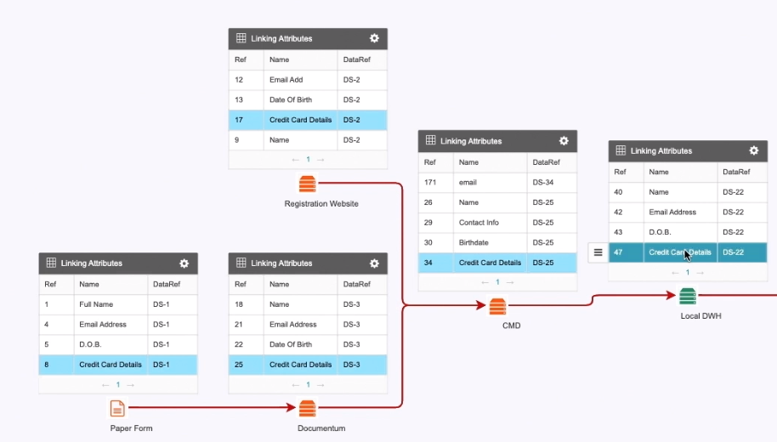
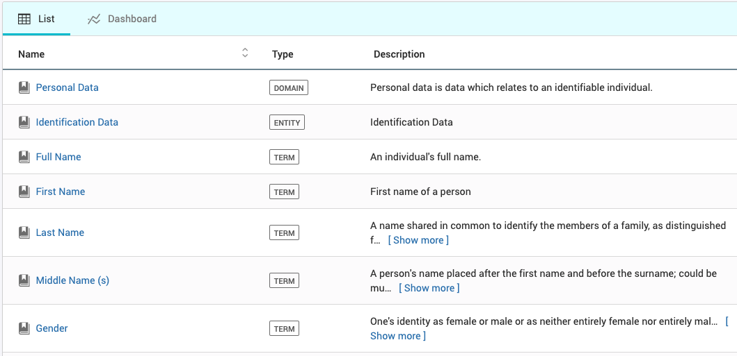
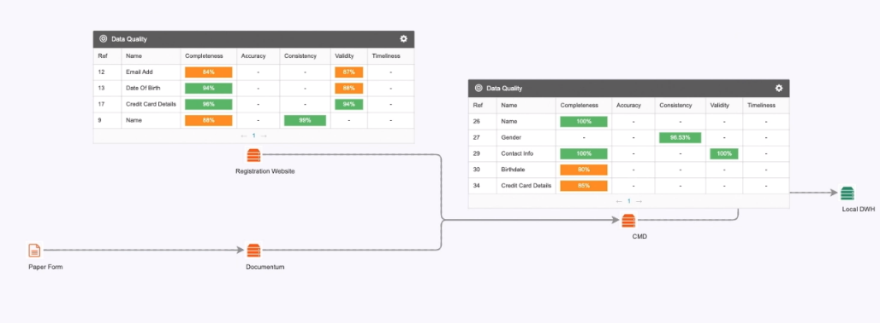
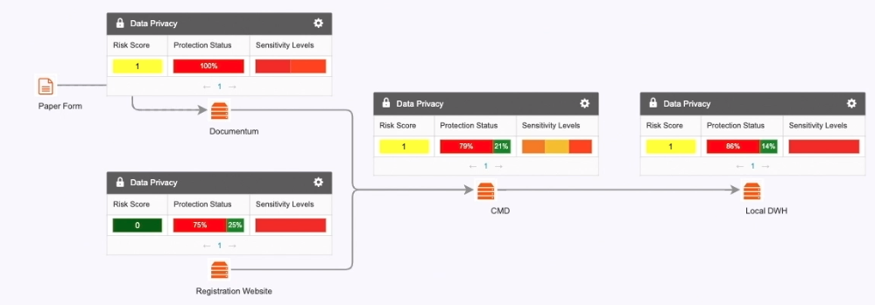
How do we provide this? With our Extensible Model
+
+
=
Data Privacy Management
Notes:
Finally, we need to be able to move beyond just definitions and start affecting real change
Click 3 x to see Axon = Gloss
A common starting point for governance is to align on semantics and agree basic definitions, but we do not want to stop there
Click 5 x to see Axon + EDC = lineage
Once we have defined our key data elements, we want to track where they are across our organisation
Click 5 x to see Axon + EDC + DQ = lineage with quality overlay
Once we understand where our data is coming from, it is natural to want to know its quality along the way
Click 4 x to see Axon + EDC + S@S = lineage with privacy overlay
Once we know where our data is and what its quality is like, we will want to be sure it is well protected
...by choosing Informatica you save yourself the headache of patching together niche solutions, and can see the whole picture in one place!

Slide 31

Customer
Video
Notes:
So how does all this help us to democratise data – BOI video.

Slide 32
Data Democratization
Turning data into actionable Information!
Kash Mehdi
Data Governance Domain Expert
Notes:
Ideas:
Start with quote
Introduce the top
Statistics
Platform overview
Self-service features
Data cataloging role
Data quality role
Privacy framework role
Key highlights summary
Demo

Slide 33
Data Democratization
Data democratization is at the heart of Nissan’s growth strategy. With over 500TB of data in their data lake, Nissan is executing aggressive plans to make data accessible to the analytics community.
- Nissan Digital
Notes:
Nissan’s quote here.

Slide 34
Survey Results: 70 Fortune 1000
Executives from corporations such as American Express, Ford, General Electric, and Johnson & Johnson admitted they weren’t where they wanted to be on the road to data democratization.
98.8% of participants identify as C-executives.
2020
2019
2018
Managing Data as a Business
Asset
Competing on Data and
Analytics
Created a
Data Driven
Organization
2017
50%
Established a
Data Culture
45.1%
37.8%
26.8%
Big Data and AI Executive Survey by NewAdvantage Partners 2020***
Notes:
executives from corporations such as American Express, Ford, General Electric, and Johnson & Johnson admitted they weren’t where they wanted to be on the road to data democratization.

Slide 35
Data Democratization Drives Business Value
Broad, consistent, and easy consumption of data for all employees
EXECUTIVE TEAMS
DATA SCIENCE TEAMS
Management Reporting
DataOps & Model Training
SELF
SERVICE
MANUFACTURING TEAMS
$
FINANCE TEAMS
Overall Equipment Effectiveness
Financial Planning & Analysis
PROCUREMENT TEAMS
MARKETING TEAMS
Spend Under Management
Personalized Next Best Offer
Notes:
What does Data Democratization looks like?
Data democratization is driving business value
Self service access to finance, marketing, manufacturing
Through providing consistent and easy to use access to data
Data sharing is essential to drive business value through data

Slide 36
DEMO

Slide 37



Customer
Lifetime
Value (CLV)
Report
David Johnson,
Business Analyst,
Finance

Slide 38

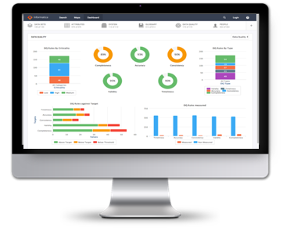

Attributes of Data Democratization Platform
Integrated, robust platform enabling self-service and productivity
Data Governance
Axon Data Governance
Automation
Discover what’s being defined. E.g. Schemas, Tables, Columns, etc.
What data do we have?
What does it mean?
What is the quality?
Where did it come from?
What is an appropriate use?
How do I access?
Who can help me?
Operationalize
Measure data quality metrics and scorecards
Enforce policies, report on risk, search subject registry, breach analysis, etc.
Enforcement
Business content of data, define processes, policies,
Ownership/stewardship and enable non-technical consumer
The ability to understand and access data.
Data Governance is about enabling organizations to easily DEFINE, DISCOVER, MEASURE,
and COLLABORATE on all data concepts.
Notes:
Kash
Let’s give you another area.
It’s not enough to just document, you have to implement and track progress over time.
This is what gives the governance practitioners the power the ability to work with confidence because they know their data is trusted.
Through this same intelligence we’re able to provide data quality so data stewards understand the quality and context of their data.
This empowers the business user and the practitioner to know how the quality of their data informs a given report.
And the quality level at a point in time as well as how it’s tracking over time.
So if quality degrades, they can use Axon to collaborate with the quality steward to implement new rules to improve the quality scores informing their report.
You see data democratization come into play as team members are able to be informed on their own and collaborate on a solution.

Slide 39
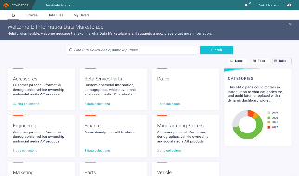
Axon Data Marketplace
Online self-service data shopping experience!
01
CREATE
03
CHECKOUT
04
TRACK ORDERS
Create and publish categories of data around customers, products, vendors, and more
Shop and request access to the data available in the marketplace
Track who is using what data for what purposes. Single view on all request accesses by multiple teams, projects, and processes
02
SHOP
05
FULLFILLMENT
Shop, Search, or Self-Service what data is available in the store and how it can be used (appropriate data quality and privacy controls)
Delivery and Auto-provisioning of data after owner approval of consumer access request
DATA
STEWARD
DATA
OWNER
DATA
CONSUMER
Notes:
Kash
Ok, so with all the buzz, you might be asking your self, what is Marketplace? Simply put, Marketplace is a feature of Axon Data Governance, available to current Kand future licensees of Axon. You can think of it like “Amazon for Data”, a storefront where data users distributed throughout the enterprise can “shop” on a self-service basis to find data relevant to their analytics or other projects. Functionally, it’s as easy to understand as it is to use…
Create the categories of data assets relevant to your data consumers.
Those consumers browse and search to find just the right, relevant data for their needs, using the business context data stewards already provided for data governance
When you find what you’re looking for, buy it. Data Governance workflows ensure all the boxes are checked to ensure timely approval and delivery
Data owners and operations teams track who gets what data, when, and for what purpose
Data Engineering teams, supported by CLAIRE™ automation, deliver data just where the consumers need it.
And that’s it. the data consumers get to find the data they’re looking for, and the data owners get to maximize the value of the data assets they publish, all on Marketplace.

Slide 40





Privacy Framework
A continuous journey!
1. DEFINE
Define and manage governance policies
Define how to process personal data
Collaborate on privacy policies / rules
2. DISCOVER
Locate and understand personal/sensitive data
Visibility across all data platforms and types
3. MAP IDENTITIES
Link persons to their personal data and consent
Index identities for identity intelligence, consent and data subject access rights
4. ANALYZE RISK | PROTECTION PLANS
Continuous analysis of data, simulation of remediation
Understand personal data risk and protection
5. PROTECT | RESPOND TO RIGHTS
Protect data, manage subject requests and consents
Automated orchestration of data protection,
fulfill subject rights requests, centralize, manage consents
6. MEASURE | AUDIT READINESS
Key risk indicators, visualizations, and reports
Track policy violations, compliance progress and communicate readiness to multiple stakeholders
Notes:
Kash

Slide 41
DEMO

Slide 42



Data Marketplace Persona Layout
Joanna Adkins
David Johnson
Adam Smith
Data Steward
Data Consumer
Data Owner
Publishes governed data
Looking to create a Customer report
Manages data access requests

Slide 43

Publish Marketplace Data
Joanna Adkins,
Domain Data Steward, Customer Data
Notes:
Marketplace enables distributed data consumers to “shop” for governed, curated data, on their own, using a simple storefront to browse, search and access relevant data. Those data assets come from the governance program, leveraging the work already done to support the organization’s data governance and compliance priorities. So, data stewards, like Joanna, here, can easily publish governed data to Marketplace for access.

Slide 44
Shopping
for Data
David Johnson,
Business Analyst,
Finance
Notes:
Like David here, a business analyst in the finance department. David wants to find data relevant to his analytics projects, regardless of where in the organization it comes from, and ensure that the data is right for his needs, trusted, and can be used consistently with the organization’s policies. Let’s see how David gets his data…

Slide 45

Manage
Data Delivery
Adam Smith, Technical Owner, Customer Master (CDL)
Notes:
Stakeholders like Adam, the Data Engineer who manages delivery of the Customer Master Data Asset to consumers who need it. Consumers like David.

Slide 46




Automation: Operationalize Data Democratization
Key Highlights:
Enabling organizations to turn data into actionable information. Informatica provides a business-friendly front end fostering collaboration between the Lines of Business, Data Governance and Data Management.
Inferred Glossary
Unison Search
AI/ML Domain Scanning
Data Marketplace
Business glossary automation powered through AI & ML. Auto link business & tech metadata
Help consumers answer business questions through google like UI. Adoption through one-click
Use out of the box functions to scan and discover metadata. Just say what you want to find
Self service e-commerce like shopping portal. Track who is using what data for what purposes.
Data Privacy
Data Quality Automation
Workflow Collaboration
Impact Analysis
Secure your data and drive policy enforcement, subject registry, risk reporting etc.
Enable business to define data quality rules in plain English text and drive automation.
Easy drag & drop workflow building capability to drive user collaboration. Attain commonality on business language
Leverage powerful visualizations and AI/ML for change management. Know the impact when changing business data assets

Slide 47
Informatica’s Governance and Privacy Framework
 | Business Objectives
OUTCOMES | Reputation | Odds of Success |  | Culture
 | Value Cost | Compliance |  | Innovation
MEASURE | Ownership |  | Business Glossary & Data Catalog
 | Quality and Privacy Controls |  | Traceability
CAPABILITIES | Data Governance & Stewardship | Metadata Management |  | Data Quality Data Privacy

Slide 48
The Data Empowerment Expert Series
Monthly webinar series featuring best practices from within our data governance & privacy community
Upcoming webinars include stories from LA Care, FIS, New York Life, Deutsche Leasing, Invesco, Genworth, UNC Health and more
Each month, we’ll publish a new story during the last week of the month
Tell your customers to subscribe to each story at www.informatica.com/dataexperts

Slide 49
Don’t Forget the Quiz!

Slide 50
Thank You

